Slide 1


GLOBAL MORTALITY TRENDS
by Youssef Fahmy

Slide 2







AGENDA OVERVIEW
Exploring Global Mortality Trends from 1990 to 2019
DEATH TRENDS OVER YEARS
MORTALITY DISTRIBUTION BY CONTINENT
Analysis of mortality data trends across the years.
Examination of how mortality rate vary across different regions and countries
AGENDA OVERVIEW
CAUSES OF DEATH OVERVIEW
LEADING CAUSES OF DEATH
Identify overview some causes lead to death.
Identify main reasons for death and their effects on global health.
LEAST CAUSES OF DEATH
FUTURE OVERVIEW
Identify least reasons that causes death.
Why should we improve healthcare ?
CONCLUSION
2

Slide 3
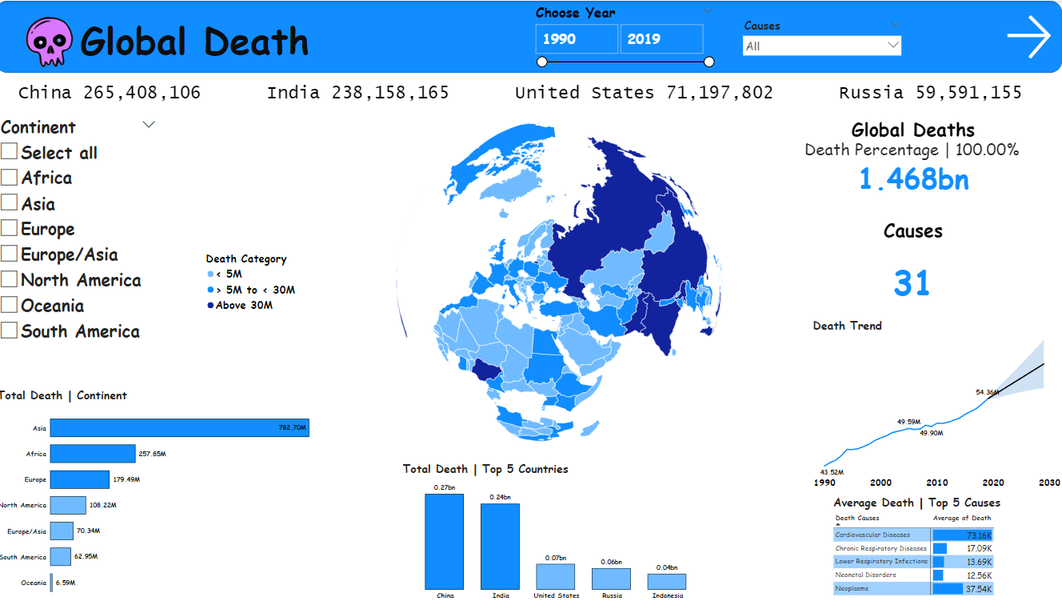

Slide 4
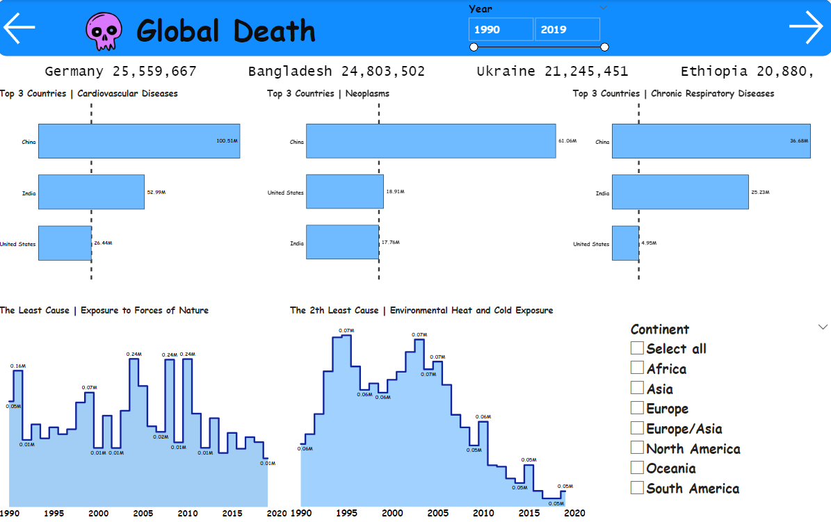

Slide 5
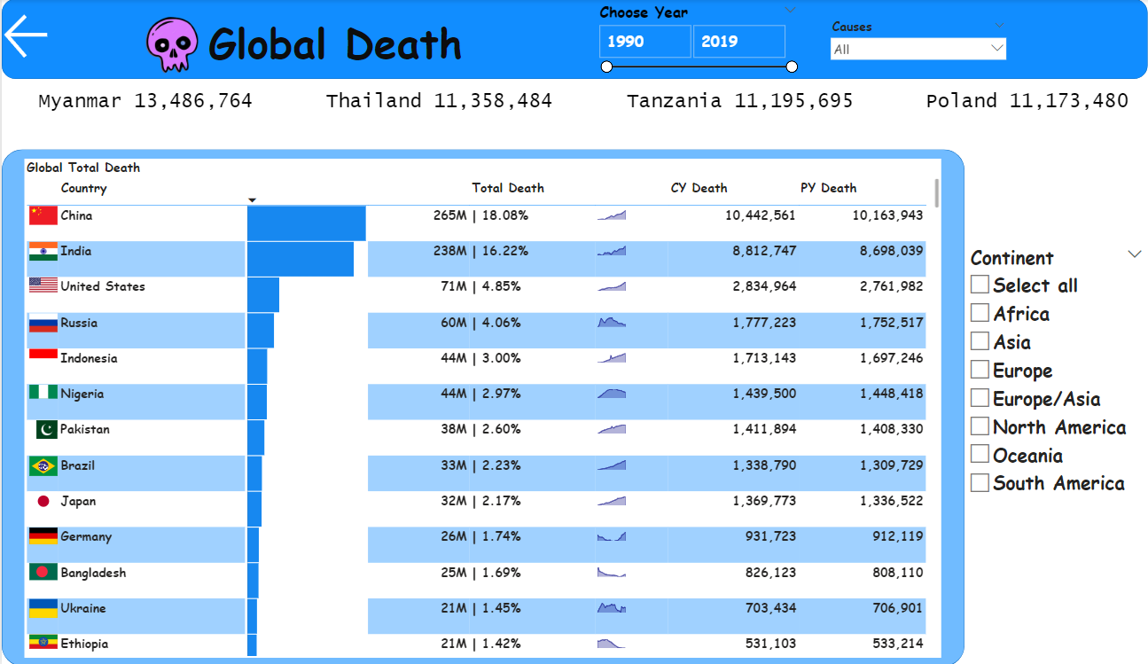

Slide 6
DEATH TRENDS OVER YEARS
3%
4%
3%
3%
LEADING CAUSES OF DEATH
TOTAL DEATHS IN 1990
TOTAL DEATHS IN 2000
TOTAL DEATHS IN 2010
TOTAL DEATHS IN 2019
In 1990, global deaths reached approximately 43.52 million. This represents a significant portion of the world’s population facing mortality, with various causes impacting different regions.
By the year 2000, global death statistics showed an increase to approximately 54.36 million. This growth highlights several health challenges faced at the time.
In 2010, deaths slightly decreased to around 49.59 million, indicating improvements in healthcare, despite ongoing challenges in specific regions.
In 2019, approximately 49.90 million deaths were recorded globally. This was before the outbreak of the COVID-19 pandemic, which had a significant impact on mortality rates and drastically altered the global health landscape.

Slide 7
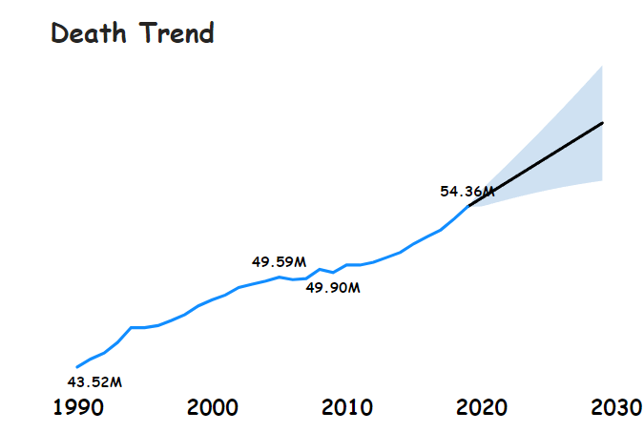
DEATH TREND OVERVIEW
FUTURE PROJECTIONS (2030)
Forecasts indicate deaths will remain around 49 to 54 million by 2030, highlighting public health advancements and demographic shifts. Understanding these changes is crucial for policy-making and resource distribution to manage future healthcare needs.
EFFECTS OF GLOBAL EVENTS
Major global events, including pandemics and conflicts, directly affect death rates. Reviewing these events helps identify patterns and inform future responses for better health outcomes. Continuous monitoring is essential to adapt to ongoing changes.

Slide 8
CONTINENTAL DEATH DISTRIBUTIONS
CONTINENT | TOTAL DEATHS (M) | PERCENTAGE OF DEATHS
Asia | 782.70 | 53.36%
Africa | 257.85 | 17.57%
Europe | 179.49 | 12.22%
North America | 108.22 | 7.37%
South America | 62.95 | 4.29%
Oceania | 6.59 | 0.45%
CONTINENTAL DEATH

Slide 9
TOP DEATH COUNTRIES
COUNTRY | TOTAL DEATHS (MILLION) | PERCENTAGE OF GLOBAL DEATHS
China | 265.41 | 18.06%
India | 238.16 | 16.22%
United States | 71.20 | 4.85%
Russia | 60.00 | 4.06%
Indonesia | 44.00 | 3.00%
TOP 5 COUNTRIES DEATH

Slide 10
TOP COUNTRIES IN DEATH BY CONTINENT
CONTINENT | TOP COUNTRY | TOTAL DEATHS (MILLIONS)
Africa | Nigeria | 10.50
Asia | China | 265.41
Europe | Germany | 36.85
North America | United States | 71.19
Oceania | Australia | 16.79
South America | Brazil | 32.78
TOP COUNTRIES IN DEATH BY CONTINENT

Slide 11
CAUSES OF DEATH OVERVIEW
CHRONIC DISEASES
INFECTIOUS DISEASES
ACCIDENTS AND VIOLENCE
Chronic diseases, such as diabetes, remain from leading causes of death worldwide. The increase in life expectancy has led to a rise in these health conditions. Prevention and management strategies are essential for reducing mortality rates. Public awareness campaigns can also help mitigate the impact of these diseases.
Infectious diseases pose a significant threat, particularly in lower-income regions with limited healthcare access. Conditions like HIV/AIDS and tuberculosis continue to contribute to mortality rates. Vaccinations and improved sanitation are critical in combating these diseases. International cooperation is necessary to address health disparities.
Accidental deaths and violence account for a large portion of mortality, particularly among younger populations. Traffic accidents and homicides significantly impact global death statistics. In addition to traffic safety measures, addressing social issues can help reduce violence. Increasing safety regulations can mitigate these accidental deaths.

Slide 12

AVG TOP 5 DEATH CAUSES
TOP 5 CAUSES OF DEATH
TOP 4 CAUSES OF DEATH
The leading causes of death globally are primarily related to chronic diseases. Cardiovascular Diseases top the list with average deaths of 73.16K annually. Following these are Chronic Respiratory Diseases at 17.09K and Lower Respiratory Infections at 13.69K. Neonatal Disorders and Neoplasms also contribute significantly with 12.56K and 37.54K deaths respectively, highlighting the urgent need for targeted health interventions.

Slide 13
LEADING CAUSES OF DEATH
30%
16%
7%
6%
TOP AVG 4 LEADING CAUSES OF DEATH
CARDIOVASCULAR DISEASES
NEOPLASMS
CHRONIC RESPIRATORY DISEASES
LOWER RESPIRATORY INFECTIONS
Cardiovascular diseases account for 30% of global mortalities, including heart attacks and strokes. These conditions necessitate ongoing public health strategies to prevent and manage.
Neoplasms make up 16% of deaths globally, highlighting the importance of cancer research and treatment availability.
Chronic respiratory diseases contribute to 7% of deaths worldwide. These diseases underline the need for improving air quality and healthcare access.
Lower respiratory infections are responsible for 6% of deaths, often impacting young and older populations, necessitating adequate healthcare responses.

Slide 14
CARDIOVASCULAR DISEASE
22%
12%
6%
TOP 3 COUNTRIES IN CARDIOVASCULAR DISEASE
CHINA
INDIA
UNITED STATES
China has the highest burden of cardiovascular diseases, accounting for 22% of total deaths. Factors include aging population and lifestyle.
India follows with 12% of deaths from cardiovascular diseases, due to urbanization and diet changes influencing health.
United States represents 6% of cardiovascular disease deaths, where lifestyle factors like obesity and smoking contribute to this statistic.

Slide 15




Cardiovascular Diseases
Heart Disease
Conditions like coronary heart disease and heart failure contribute to a significant number of deaths globally.
CARDIOVASCULAR DISEASE
Risk Factors
Preventions
Risk factors for cardiovascular disease include high blood pressure, smoking, and unhealthy diets.
Lifestyle modifications, such as regular exercise and a balanced diet, can help prevent cardiovascular diseases.

Slide 16
NEOPLASMS STATISTICS
27%
8%
8%
TOP 3 COUNTRIES IN NEOPLASMS
NTRI
CHINA
INDIA
UNITED STATES
China has the highest incidence of deaths from neoplasms at 27%. This highlights significant public health concerns related to cancer.
India accounts for 8% of neoplasm deaths, influenced by late diagnoses and limited healthcare resources.
United States shows 8% of deaths from neoplasms, emphasizing the impact of healthcare access and early detection efforts.

Slide 17
Neoplasms
Types
Risk Factors
Treatment
NEOPLASMS
Cancers can affect various organs and tissues, including the lungs, breast, and prostate.
Factors like smoking, exposure to carcinogens, and genetics can increase the risk of cancer.
Treatment options for cancer include surgery, radiation therapy, and chemotherapy.

Slide 18
CHRONIC RESPIRATORY ISSUES
35%
24%
5%
TOP 3 COUNTRIES IN CHROIC RESPIRATORY
CHINA
INDIA
UNITED STATES
With 35% of chronic respiratory disease deaths, China's air pollution and smoking prevalence significantly affect public health.
India represents 24% of deaths, where urban pollution and poor respiratory health resources play a role.
United States has 5% of deaths attributed to chronic respiratory diseases, with ongoing issues from smoking and environmental factors.

Slide 19




CHRONIC RESPIRATORY
Pneumonia
Inflammation of the lungs caused by infection, often leading to difficulty breathing and fever.
CHROIC RESPIRATORY
Chronic Obstructive Pulmonary Disease
A group of lung diseases that cause airflow obstruction and breathing difficulties, often due to smoking.
Asthma
A chronic condition characterized by inflammation and narrowing of the airways, leading to wheezing and shortness of breath.

Slide 20

Infectious Diseases
Disease
Transmission
Symptoms
HIV/AIDS
Bodily fluids
Weakened immune system
Tuberculosis
Airborne droplets
Coughing, fever, night sweats
Malaria
Mosquito bites
Fever, chills, sweating

Slide 21

Unintentional Injuries
1
Road Traffic Accidents
A leading cause of unintentional injury deaths, particularly in low- and middle-income countries.
2
Falls
Falls are a significant cause of injuries, especially among older adults and young children.
Unintentional Injuries
3
Drowning
A preventable cause of death, particularly in children and those who are not strong swimmers.
4
Fires
Fire-related injuries and deaths can be reduced through fire safety measures and awareness.

Slide 22
LEAST CAUSES OF DEATH
CAUSE | 1990 | 2019
Exposure to Force of Nature | 0.05M | 0.01M
Environmental Heat and Cold Exposure | 0.13M | 0.11M
LEAST CAUSES OF DEATH

Slide 23


INCREASING MORTALITY RATES
AGEING POPULATION IMPACT
INCREASING MORTALITY RATES
An ageing population contributes significantly to rising mortality rates globally. Countries with a higher median age may experience a greater burden from age-related health issues. Societal adaptations in healthcare and services are vital to manage the associated challenges.
HEALTHCARE ACCESS ISSUES
Limited healthcare access in many underdeveloped and developing countries has worsened mortality rates. Lack of resources, healthcare infrastructure, and trained personnel lead to increased disease prevalence. Addressing these access issues must become a global priority for health organizations.

Slide 24


FUTURE DEATH PREDICTIONS
HEALTHCARE CHALLENGES AHEAD
With global populations aging and new diseases emerging, healthcare systems may face immense pressure. Innovations in medical technology and public health strategies will be crucial to mitigate future death increases.
FORECASTING TRENDS
Based on current data, death trends are expected to evolve due to improvements in healthcare. However, potential spikes due to pandemics or other global crises remain a concern. Understanding these factors is essential for long-term health planning.

Slide 25

CONCLUSION
CONCLUSION
SUMMARY OF KEY FINDINGS
The global death trends reveal critical insights into health improvements and ongoing challenges. Key statistics indicate that while death rates have stabilized in recent years, factors like healthcare access and disease prevalence remain pivotal. Understanding these trends allows for better preparedness and response to future health challenges.
Asia and Africa experience the highest global death counts.
The top 5 countries contribute over 50% of global deaths, with China and India being the largest contributors. Cardiovascular diseases remain the leading cause across these regions. Top 5 countries account for a significant percentage of global mortality.
Less frequent causes like exposure to natural forces remain low but consistent over time.

Slide 26

NeuroNetix
Pivot tables analyzing key aspects of the dataset and Visual charts
By: Mohamed Mohy

Slide 27


Overview
Introduction
03
importance of charts
04
first chart
05
second chart
06
third chart
07
fourth chart
08
fifth chart
09
conclusion
10

Slide 28
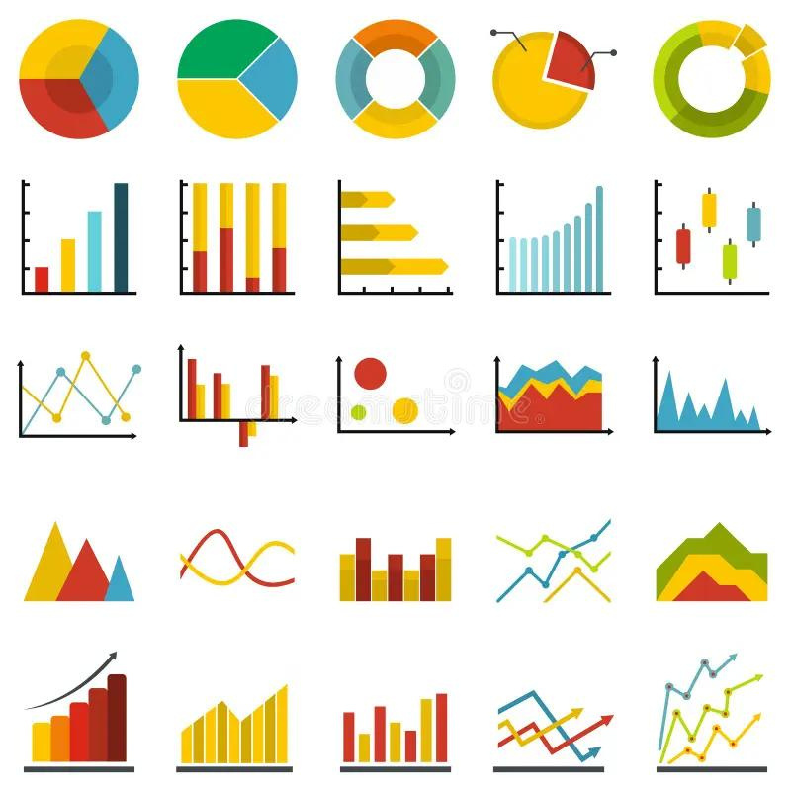
Introduciton
Pivot tables are powerful data analysis tools used in Excel, Power BI, and other data analysis platforms to summarize, analyze, and present large datasets. They enable users to organize data in a tabular format, making it easier to extract valuable insights by rearranging rows and columns.
Visual charts, like pie charts and bar charts, are graphical representations of data that help to convey complex information in a more digestible and understandable way.

Slide 29


Importance of Visual Chart
1- Visual charts convert complex data into easy-to-understand visuals, making it simpler to identify patterns, trends, and relationships.
2-Charts provide a quick overview of key information, allowing users to grasp important insights at a glance, which is especially valuable for decision-making.
3- They enable quick comparisons between different categories, time periods, or groups, helping to highlight differences and similarities in data.
4-By clearly showing trends, outliers, and patterns, visual charts assist in informed decision-making

Slide 30
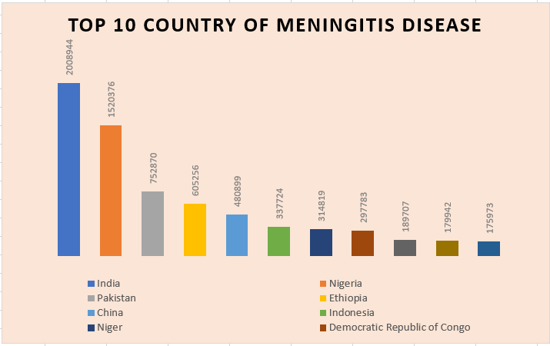
In This Figure That Show The Top 10 Country of Meningitis Disease
Figure (1)

Slide 31
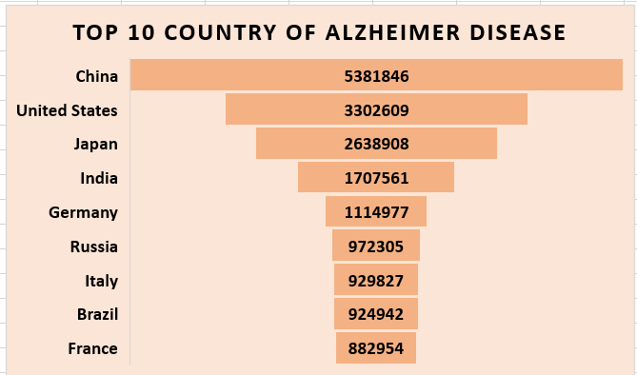
In This Figure That Show The Top 10 Country of Alzheimer Disease
Your paragraph text
Figure(2)

Slide 32
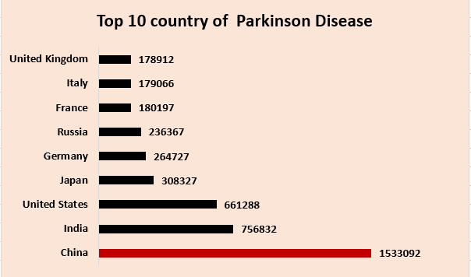
In This Figure That Show The Top 10 Country of Parkinson Disease
Figure(3)

Slide 33
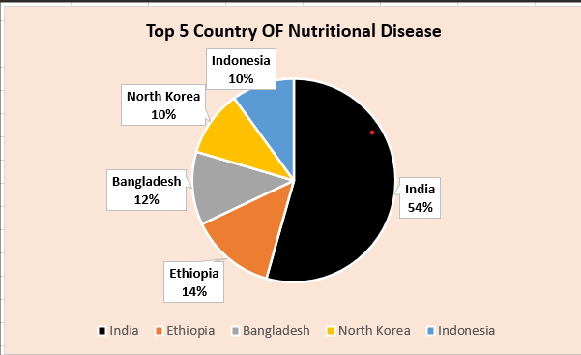
In This Figure That Show The Top 5 Country of Nutritional Disease
Figure(4)

Slide 34
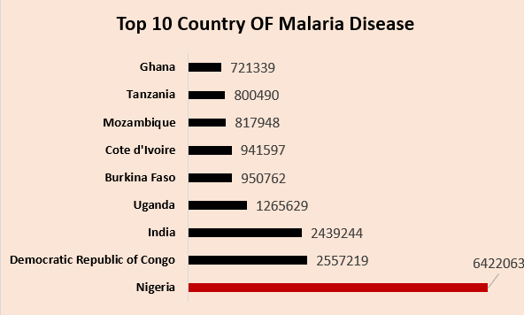
In This Figure That Show The Top 10 Country of Malaria Disease
Figure(5)

Slide 35
Conclusion
Pivot tables and visual charts are indispensable tools in data analysis and reporting, each offering unique advantages in understanding and interpreting data.
Pivot tables provide a flexible and efficient way
allowing users to extract valuable insights through easy data
They enable quick identification of trends, patterns

Slide 36


PRESENTATION
By : Abdellah Mohamed

Slide 37

introducttion
Python has become one of the most popular programming languages for data analysis due to its simplicity, flexibility, and powerful libraries. It provides a comprehensive environment for handling, analyzing, and visualizing data, making it a go-to tool for data scientists, analysts, and researchers. Here’s an overview of why Python is ideal for data analysis and the key libraries used in this field.
1.

Slide 38

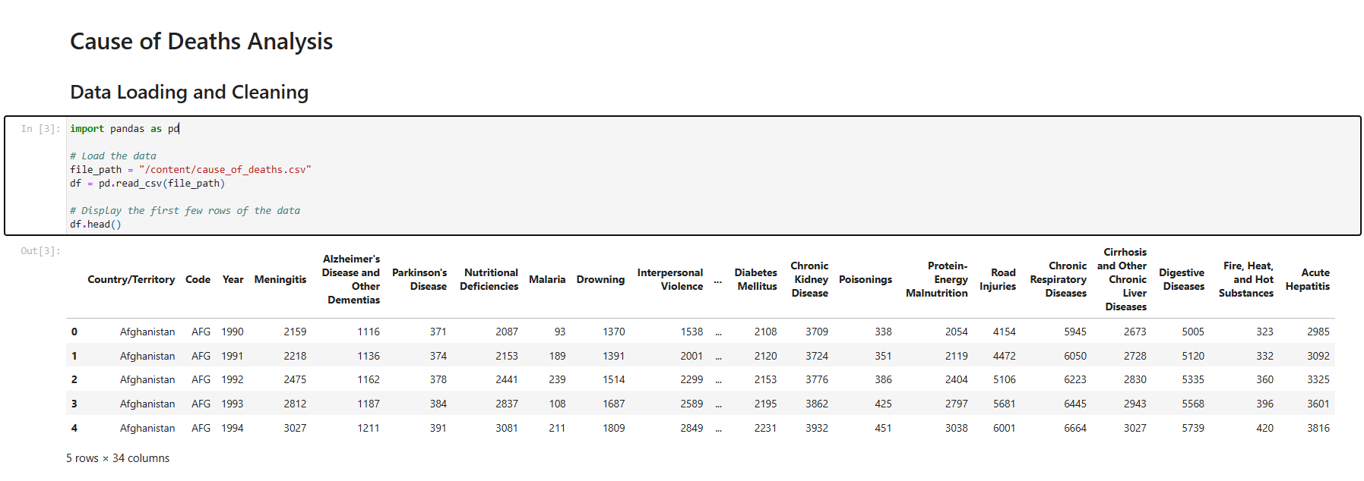
data Loading and cleaning
2.

Slide 39
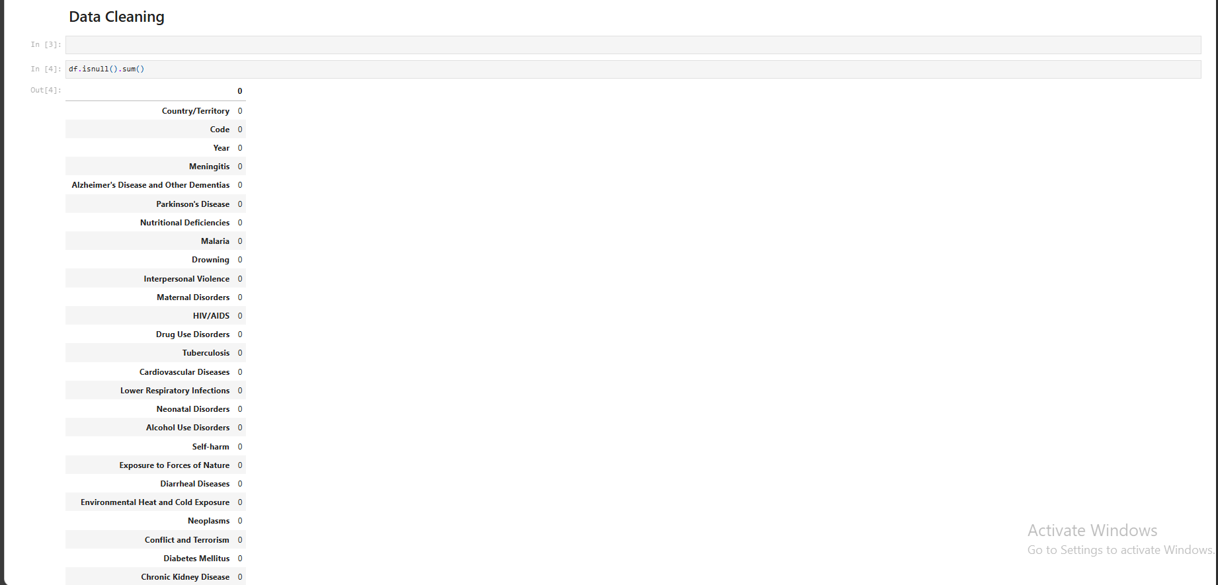
data cleaning

Slide 40

information of data

Slide 41
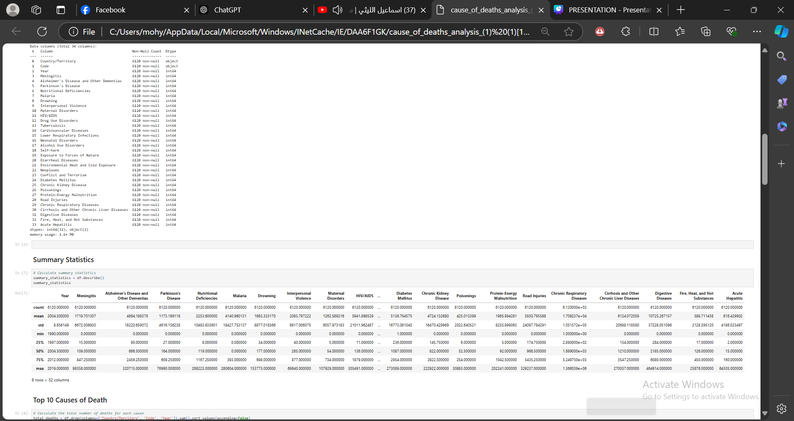
Summary Statistics

Slide 42
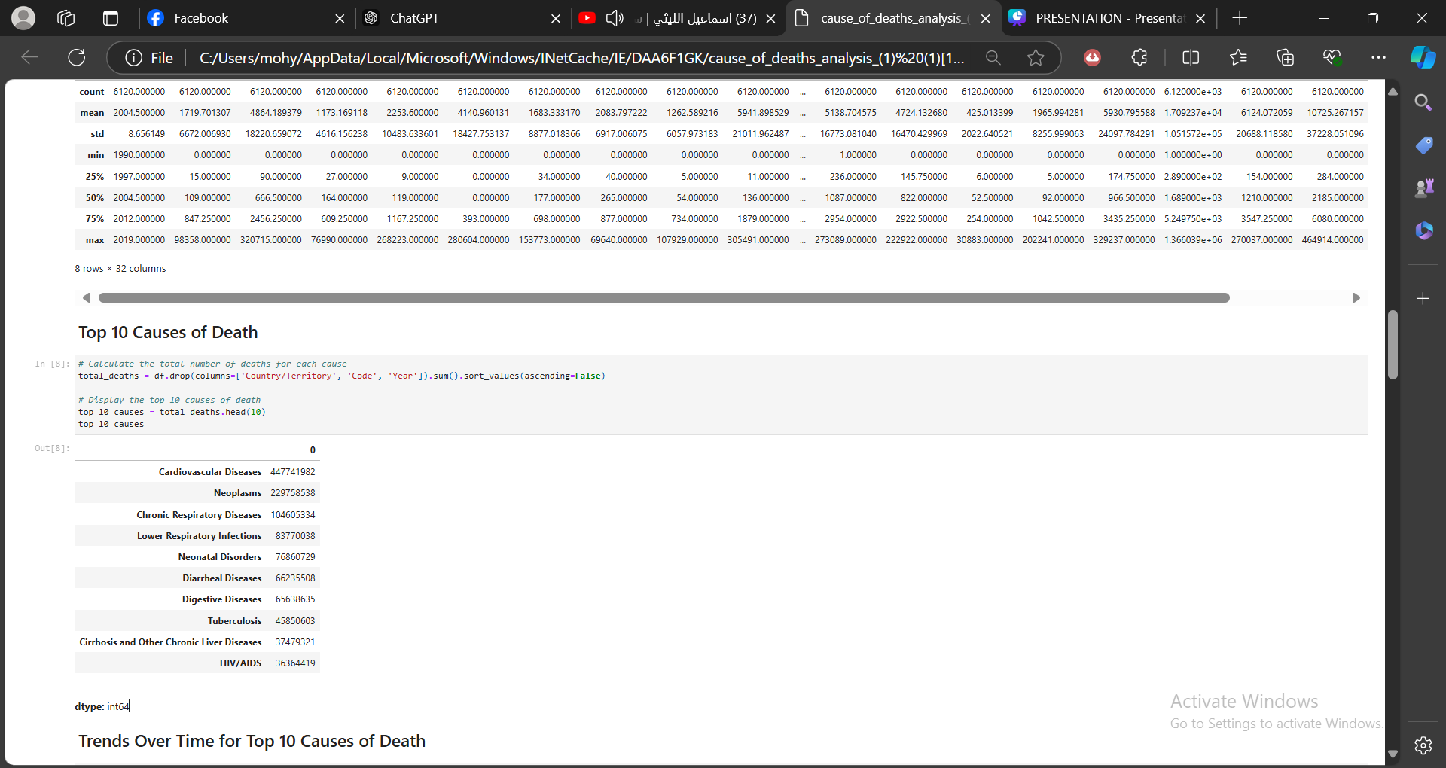
Top of causes death

Slide 43
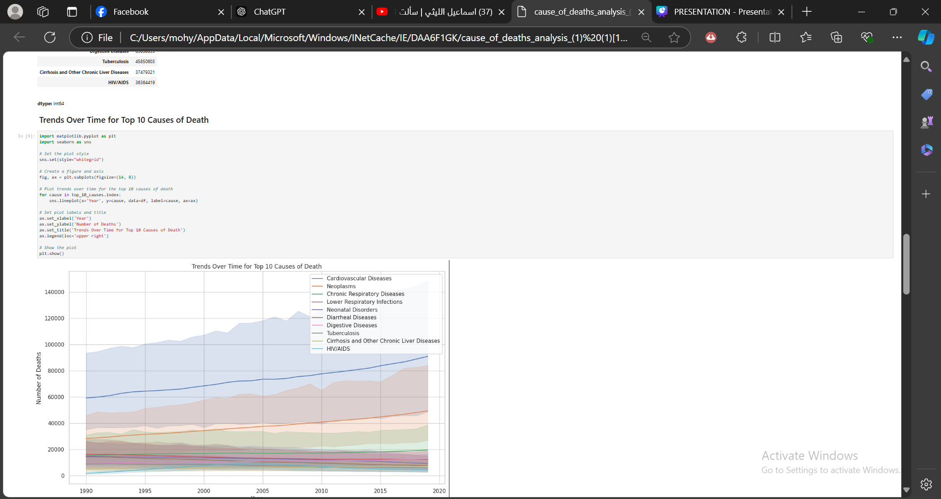
Trends Over Time for Top 10 Causes of Death

Slide 44
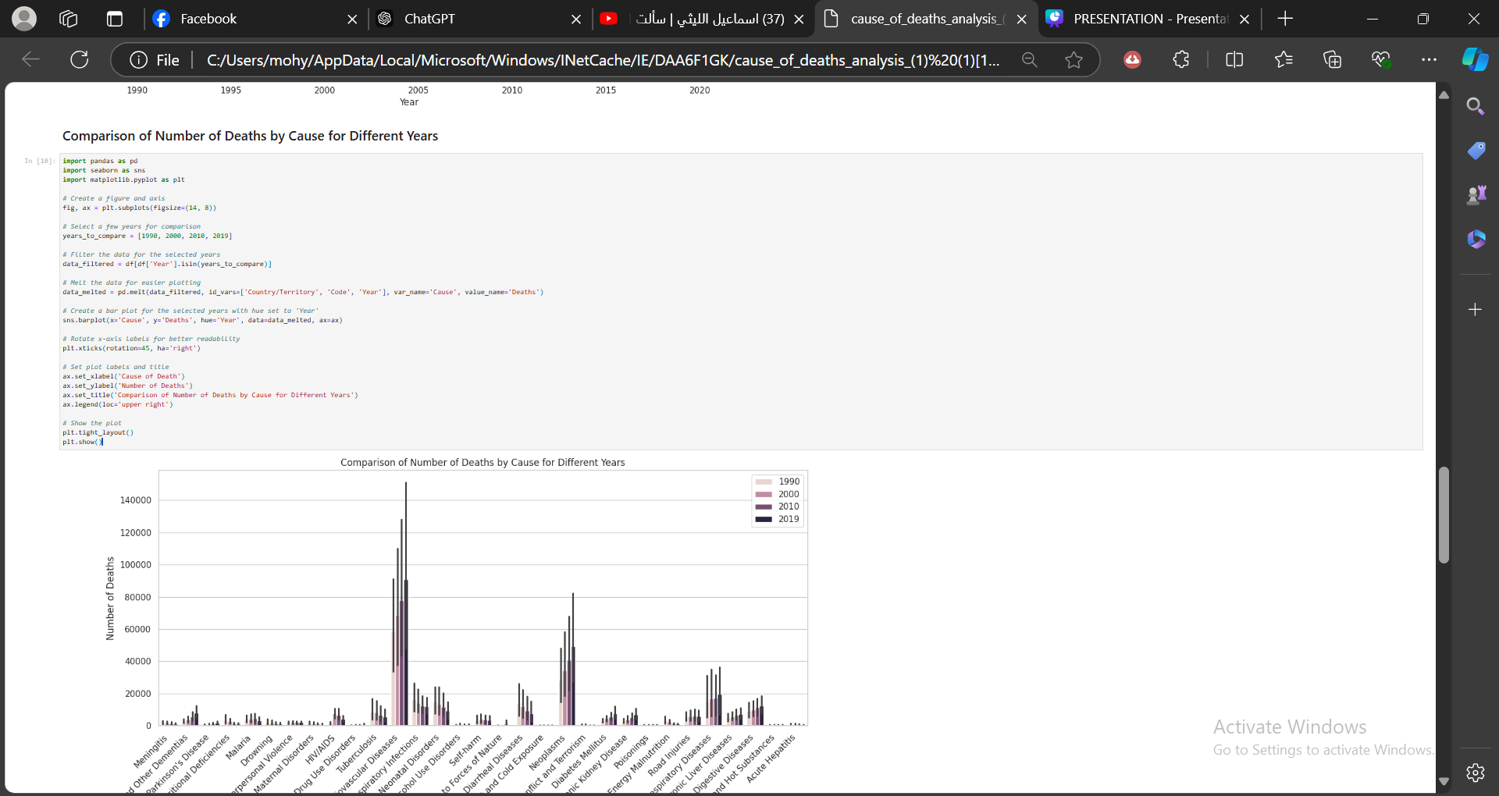
Comparison of Number of Deaths by Cause for Different Years

Slide 45
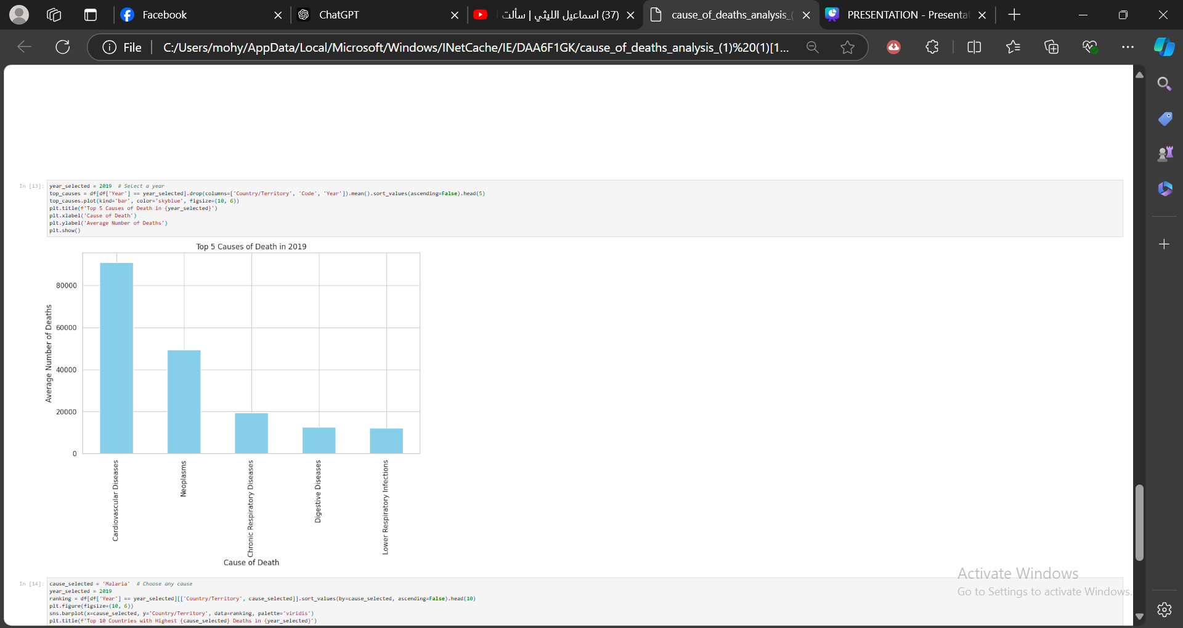
Correlation Matrix of Causes of Death

Slide 46
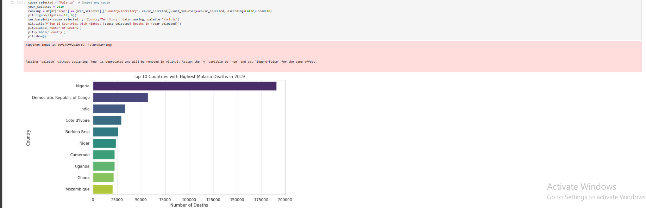
Top countries with highest's malaria in 2019

